Slide 1
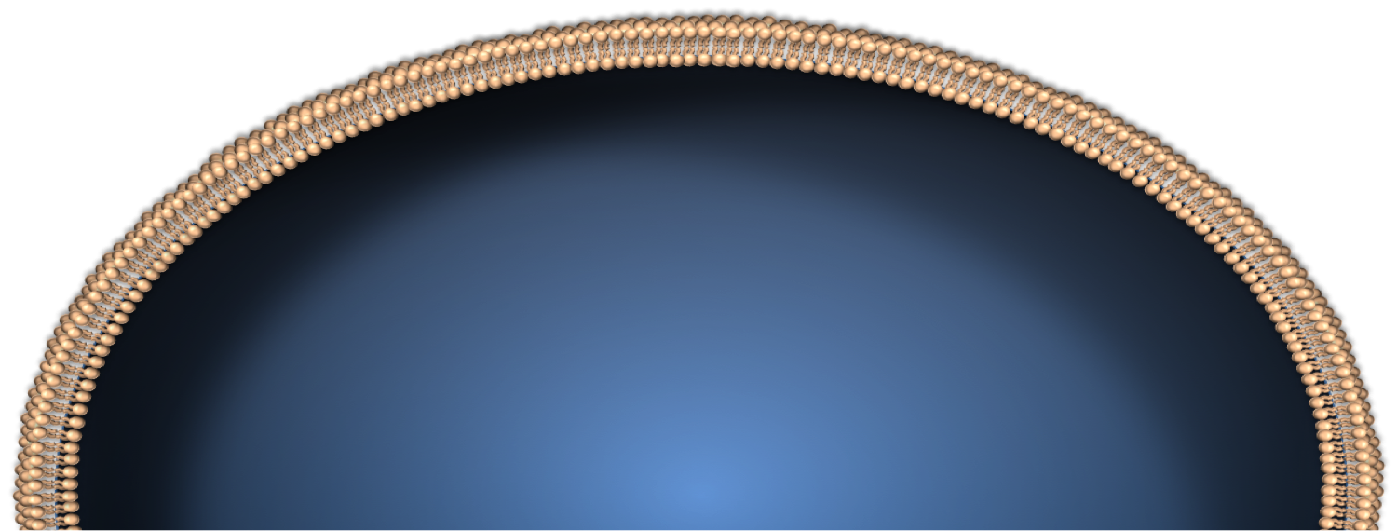

MC1R
⍺-MSH
Adenylate
Cyclase
c-KIT
Gs⍺
RAS
NF1
RAS
Shc
Grb
RAS
NF1
RAS
PI3K
PIP₂
cAMP
ATP
SOS
GTP
GDP
GDP
GTP
PIP₃
PTEN
BRAF
AKT
PKA
BAD
MEK
mTOR
BCL2
CREB
PGC1 ⍺
ERK
P16^{INK4A}
CDK4/6
Cyclin D
Rb
P
Jun
c-Fos
Cell Proliferation
E2f
Rb
Ub
Bap1
ACD
POT1
Ub
H2A
MITF
XRCC3
E2f
TERF
H2A
TERT
Notes:
CDKN2A founder mutations have been reported to range from 5 – 40% of melanoma families, depending on geographic origin

Slide 2
Legend for Melanoma Pathways Figure
Mitogenic stimuli from growth factor receptors such as c-KIT result in activation of RAS. Output from RAS promotes cell proliferation and survival by activating the MAPK kinase pathway (BRAF-MEK-ERK) and the PI3K-PIP3-AKT pathway.
Cell proliferation is triggered by increased transcription of cyclin D family members via output from both MAPK and PI3K signaling. MAPK signaling induces expression of cyclin D1, via JNK, ERK and AP-1 (Jun and c-fos), which leads to the liberation of E2F.
Transcription of cyclin D is also promoted when AKT activation stimulates mTOR to inhibit 4E-BP1, a suppressor of eIF4E.
In addition, cyclin D–CDK4/6 complexes promote cell growth by stabilizing FOXM1 through multisite phosphorylation, leading to the expression of mitogenic genes, such as CDK1 and members of the cyclin A, B, D and E families.
The RAS-PI3K pathway also antagonizes the GSK3b phosphorylation of cyclin D–CDK4/6 complexes, which results in ubiquitination and proteasome degradation.
Several antiapoptotic pathways are induced downstream of RAS. RSK activation of CREB upregulates BCL2 and antagonizes apoptosis at the level of the mitochondria.
BCL2 activity is further promoted by the AKT-mediated phosphorylation, and subsequent inhibition, of the pro-apoptotic BAD.
RAS is downregulated by GTPase-activating proteins such as NF1, which facilitates the hydrolysis of GTP to GDP. Conversely, GEFs stimulate the release of GDP to allow for binding of GTP by RAS and subsequent activation.
Miller DM, Flaherty KT. Pigment Cell Melanoma Research. 2014 Jan

Slide 3
Cyclin A
RAS
CDK2
P
P
Rb
HDAC
BRAF
CDK1
E2F
DP
S-phase genes
Cyclin A
p16^{INK4A}
P
Rb
HDAC
P
P
P
CDK4/6
S
Cyclin D
Rb
HDAC
Nearly 100% of melanomas have an aberration in this pathway
HDAC
Rb
G₂
E2F
DP
Restriction Point
G₁
M
G₀
P
P
P
Quiescence
Differentiation
Senescence
HDAC
Rb
P
P
P
Cyclin B
Rb
HDAC
CDK1

Slide 4
Legend for Cell-Cycle Figure
The cell cycle is regulated by the dynamic interactions of highly coordinated enzymatic proteins to ensure genomic fidelity.
Cells first enter the cell cycle after receiving mitogenic signals, from stimuli such as RAS, which activate the cyclin D-dependent kinases, CDK4 and CDK6, via increased expression of cyclin D and by triggering release from inhibitory INK4 (p15 and p16) and CIP/KIP (p21CIP1 and p27KIP1) proteins.
Early in G1, RB is initially phosphorylated by cyclin D–CDK4/6 complexes, which abrogates the RB-dependent inhibition of the transcription factor E2F.
E2F transcription factors are then released from the partially phosphorylated RB and promote transcription of genes (e.g. CCNE1) necessary to progress through the G1/S checkpoint.
RB is further phosphorylated in late G1 by cyclin E–CDK2 complexes, enabling E2F transcription factors to express genes required for DNA synthesis.
After entry into the S phase, a hyperphosphorylated state of RB is maintained by the activities of cyclin A–CDK2, cyclin A–CDK1 and cyclin B–CDK1 complexes.
At the end of mitosis RB proteins are dephosphorylated by phosphatases allowing recombination with E2F and DP to prevent unregulated cell proliferation. The cell cycle is negatively regulated by members of the INK4 (p15, p16) and CIP/KIP families (p21CIP1 and p27KIP1)
Reference: Miller DM, Flaherty KT. Pigment Cell Melanoma Research. 2014 Jan

Slide 5
Intact
Degraded
Mutated in Li- Fraumeni Syndrome
p53
Cell-cycle arrest
Apoptosis
Survival
Replication
Growth
MDM2
p14^{ARF}
Alternatively Spliced Gene Products
CDKN2A
Neoplasia
E1β
E1α
E₂
E₃
25% of familial melanoma kindreds have germline mutations in CDKN2A
p16^{INK4A}
CDK4 is also mutated in familial melanoma
Cell growth
Proliferation
CDK4/6
Growth Arrest
Cyclin D
P
P
Rb
Rb
E2F
DP
Active
Inhibited
Figure adapted from Bolognia, Jean., Jorizzo, Joseph L.Schaffer, Julie V. (Eds.) (2012) Dermatology
E2F
DP
Notes:
Transcripts utilizing the E1a exon produce p16INK4A, which inhibits CDK4/6, and those with the E1b element transcribe the MDM2- inhibitor p14ARF

Slide 6
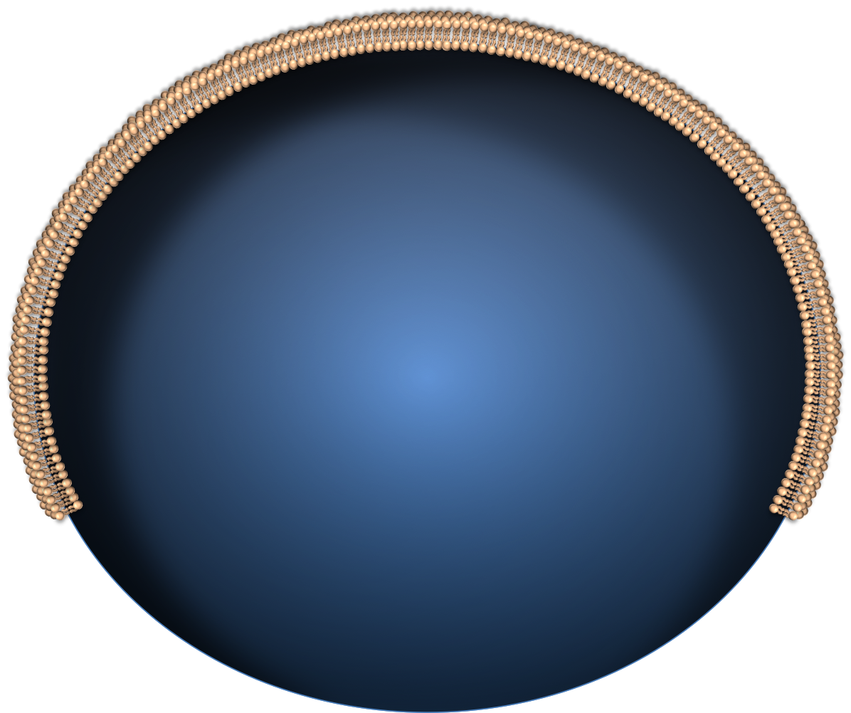
c-KIT
Shc
Grb
RAS
ARF
SOS
UV Radiation
MDM2
BRAFV600E
ATR
ATR
ATM
MEK
p53
CHK2
ATM
ERK
p21
JNK
P16^{INK4A}
CDK4/6
CDK4/6
Cyclin D
DNA Damage
Rb
Jun
c-Fos
Cell Proliferation
E2f
Rb
Telomere Attrition
Hyper-Replicative DNA
E2f
Transcription
SAHF
Notes:
Although more than 40 different mutations in BRAF have been described,3 the most clinically relevant mutation is the BRAFT1799A, which results in the substitution of valine by glutamic acid (V600E) in the kinase domain of the protein. 90% of the clinically relevant mutations are V600E; 10% are V600K, where valine is changed to lysine

Slide 7
Legend for Senescence Figure
The cellular senescence program can be initiated via several pathway outputs that utilize common effector molecules.
While the mechanisms governing senescence have yet to be fully described, telomere shortening is believed to trigger cellular arrest by activating INK4a-RB signaling and the p53-p21 pathway via molecules such as ATM, ATR and CHK2.
Permanent inactivation of CDKs can also occur downstream of the DNA damage response (DDR), which can be triggered by a variety of genotoxic stimuli including ultraviolet (UV) radiation, reactive oxygen species (ROS) and hyper-replicative DNA (HRD)
The DDR stimulates INK4a-mediated inhibition of CDK4/6 and the p53-p21 pathway in part via ARF inhibition of MDM2-mediated ubiquitination of p53 and activation of ATM
Activation of INK4a inhibits the CDK4/ 6-mediated activation of FOXM1, which antagonizes ROS-mediated DNA damage.
The senescence cascade is also activated in certain contexts of persistent mitogenic stimulation, such as constitutive activation of RAS or RAF proteins (referred to as oncogene-induced senescence (OIS)
OIS involves p38 MAPK and activates RB and p53 via HBP1 and PRAK, respectively
Active RB contributes to formation of senescence-associated heterochromatin foci (SAHF), and this heterochromatization of DNA precludes transcription of E2F target genes, contributing to the overall state of irreversible cell-cycle arrest.
Reference: Miller DM, Flaherty KT. Pigment Cell Melanoma Research. 2014 Jan

Slide 8
Prognosis
Stage I-II
Stage III
Gershenwald. CA Cancer J Clin. 2017.

Slide 9
Therapeutic Strategies for Melanoma
Immune-Directed Therapy
Immune-Directed Therapy
Oncogene-Directed Therapy
Notes:
However, both are, quite frankly, targeted therapies, and therefore I choose to regard them as either immune-directed or oncogene-directed

Slide 10
Approved Therapies for Advanced Melanoma
Sylatron (Peg-IFN-alfa-2b) for adjuvant
Tafinlar
(Dabrafenib)
------------------
Mekinist
(Trametinib)
For Stage IV
Yervoy (Ipilimumab) as Adjuvant
Combination Encorafenib & Benimetinib For Stage IV Dz
Imlygic
(talimogene laherparepvec)
DTIC
(Dacarbazine)
Aldesleukin
(IL-2)
Yervoy (Ipilimumab) for Stage IV Dz
Opdivo
(Nivolumab) for Stage IV
Opdivo (Nivolumab) for Adjuvant
December
1967
December
1995
August
2011
Sept.
2014
Sept.
2015
Nov 2015
April 2018
Feb.
2019
May
1975
January
1998
March 2011
May 2013
Dec.
2014
Oct 2015
Dec
2017
June
2018
Hydrea (Hydroxyurea)
Intron A
(Interferon-α2b) for Adjuvant
Zelboraf (Vemurafenib)
Keytruda
(Pembrolizumab)
Combination Dabrafenib &
Trametinib for Adjuvant Dz
Ipilimumab & Nivolumab in Combination for Systemic Dz
Keytruda
(Pembrolizumab)
as adjuvant Tx
Combination Dabrafenib &
Trametinib for Systemic Dz
------------------
Combination Vemurafenib & Combimetinib for Syst Dz
Notes:
29 approvals in melanoma

Slide 11
Treatment Options for Stage III Melanoma
Resected Nodal Disease
IIIA (T_{1-2a}N_{1-2a}M₀) (10 yr MSS: 88%)
If BRAF wild type:
Observation or Adjuvant Pembro or Nivolumab x1 year
If BRAFV600E mutated
Observation vs. Dabrafenib/Trametinib vs. Pembro or Nivolumab x1 year
IIIB/C/D (10 yr MSS: 77%, 60%, 24%, respectively)
If BRAF wild type:
Adjuvant Nivolumab (approved Dec 2017)
Adjuvant Pembro (approved Feb 2019)
If BRAFV600E mutated
Dabrafenib/Trametinib (approved April 2018) or Nivolumab or Pembro

Slide 12







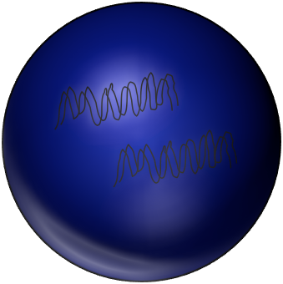

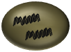



IL-2
Ipilimumab
CTLA4
IL-2R
Nivolumab
CD80/86
Activating Signals
PD-1
PD-L1
CTLA4
Pembrolizumab
CD80/86
Inhibitory Signals
CD28
MHC 1/2
TCR
Activating Signals
CD4/8
MHC 1
PD-1
Inhibitory Signals
TCR
PD-L1
Avelumab
Inhibitory Signals
Avelumab
APC
PD-L1
PD-1
PD-1
PD-L1
Melanoma
Nivolumab
PD-1
PD-L1
PD-L1
PD-1
Pembrolizumab
T Lymphocyte
Miller D, Flaherty K, and Tsao H. Seminars in Cutaneous Medicine and Surgery, Vol. 33, June 2014

Slide 13
Legend for Immunotherapy Figure
T-cell activation results from the summation of several activating signals.
These include stimulation of the T-cell receptor (TCR) by an antigen complexed with the major histocompatibility complex (MHC) and CD28 by CD80 or CD86 (CD80/86).
Of note, MHC class I molecules activate CD8⁺-T cells, while MHC class II molecules are recognized by CD4⁺-T cells.
T-cell activation and function are tightly calibrated by regulatory mechanisms to prevent autoimmunity and excessive tissue inflammation.
T-cell activation is negatively regulated by CTLA4, which not only competes with CD28 for CD80 and CD86, but can also transmit inhibitory signals that attenuate activation. In peripheral tissues, ligation of the program death-1 (PD-1) receptor by PD-L1 inhibits effector functions of T-cells.
PD-L1 is expressed on both antigen-presenting cells, such as macrophages, and malignant melanocytes.
Monoclonal antibodies directed against CTLA-4 (ipilimumab), PD-1 (nivolumab and Pembrolizumab) and PD-L1 (Avelumab/Atezolizumb; of note, neither are approved for melanoma, but are approved for other malignancies) can overcome intrinsic immune checkpoints by licensing tumor-specific T cells.
Reference: Miller D, Flaherty K, and Tsao H. Seminars in Cutaneous Medicine and Surgery, Vol. 33, June 2014

Slide 14
Therapeutic Algorithm for Metastatic Disease
Clinical Trial
Progression
Clinical Trial
Progression
*
Clinical Trial
BRAF^{V600E}
Pembro or Nivo
Ipilimumab
IL-2
BRAFi + MEKi
BRAFi + MEKi
Stage IV
BRAF^{WT}
Clinical Trial
Progression
Clinical Trial
Progression
Clinical Trial
*
Pembro or Nivo
Ipilimumab
IL-2
*In some cases, Ipi/Nivo combo is used as first line therapy. However, in PD-L1 positive tumors, single agent anti-PD1 (nivo or pembro) may be just as good as combination therapy, and thus is often used a single agent d/t fewer immune-related adverse effects. This is typically a conversation b/t physician and patient. This treatment algorithm is a fast-moving train is is being altered/updated on a recurring basis.
Notes:
For our patient with a detected BRAF mutation

